Slide 1

Smart Helmet Crash Detection System
The Smart Helmet Crash Detection System is an innovative solution designed to enhance rider safety by integrating real-time accident detection. By combining advanced sensors, GPS tracking, and communication modules, this system aims to provide immediate alerting during crashes. The approach not only improves timely emergency response but also paves the way for safer motorcycle travel through affordable IoT technology integration.
By:-
Sidharth Subramonian (230701315)
Sivaramakrishnan R (230701319)

Slide 2
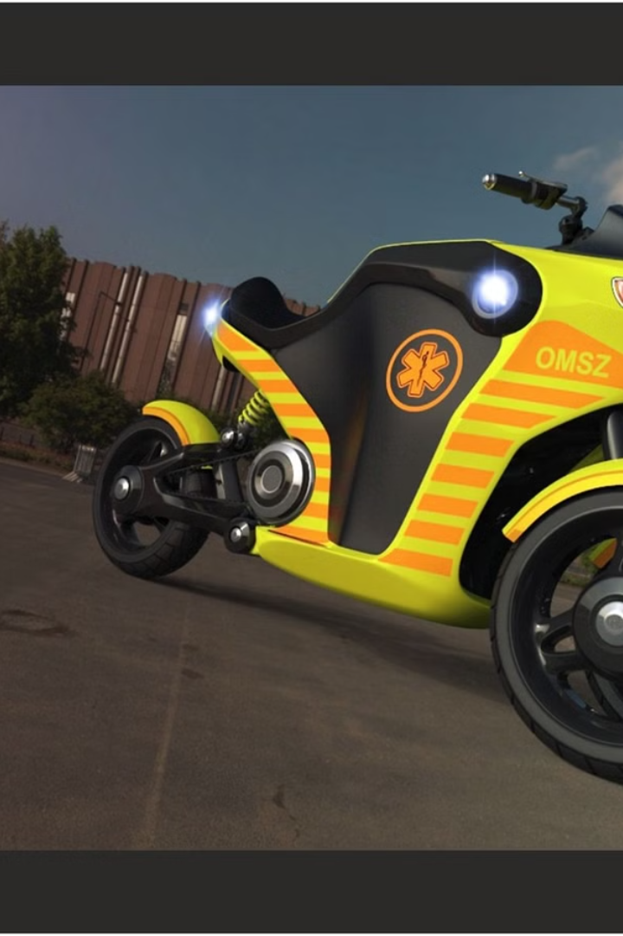
Abstract
The Smart Helmet Crash Detection System is an innovative IoT-based safety solution designed for motorcycle riders. It combines a Raspberry Pi 4, an MPU6050 motion sensor, and an ultrasonic sensor to detect accidents and helmet usage. Upon detecting a crash, the system automatically sends SOS alerts through a Telegram bot to emergency contacts. By ensuring timely assistance after accidents, this system aims to significantly reduce fatalities caused by delayed emergency response.

Slide 3

Introduction
Motorcycle riders are highly vulnerable in traffic accidents, accounting for a major portion of road fatalities. Traditional helmets offer passive protection but lack active emergency communication features. Delayed medical response after an accident often leads to preventable deaths. There is a critical need for smart helmets that can autonomously detect accidents and notify emergency contacts instantly. This project addresses that gap with an affordable, IoT-based crash detection system.

Slide 4

Objective
Automatic Crash Detection
Develop technology to detect motorcycle accidents in real-time without manual input.
Helmet Usage Confirmation
Ensure system readiness by confirming helmet wear during rides through embedded sensors.
Immediate SOS Alerts
Send instant alerts with location details to emergency contacts to facilitate quick aid.
Affordable Safety
Implement cost-effective IoT-based solutions to enhance accessibility for riders globally.

Slide 5
Literature Survey
Title | Author(s) | Summary | Limitations
Smart Helmet Technology: An Overview | Various Authors | This article provides a comprehensive review of smart helmet technologies, covering applications like crash detection, rider safety, augmented reality (AR) integration for navigation, and IoT integration using sensors like accelerometers and GPS. | The review lacks discussions on power management, network security, and scalability. It also doesn’t address software frameworks or platforms that streamline development.
IoT-Based Smart Helmet for Riders’ Safety | R. Sharma et al. | Focuses on the development of an IoT-based helmet that uses an accelerometer for crash detection, embedded microcontrollers for data processing, and a mobile alert system for accident notifications with GPS coordinates. | Evaluation is limited, especially in real-world environments. The study doesn’t fully address issues related to the helmet’s durability or the reliability of the notification system.
Crash Detection and Alert Systems for Motorcycles: A Review | P. Rajendran, V. Ravi | Reviews various technologies for crash detection in motorcycle helmets using sensors like accelerometers, gyroscopes, and GPS. Discusses emergency alert systems like SMS and cloud-based notifications. | Lacks consideration of other safety features like wear detection or rider location identification. Doesn’t explore the integration of multiple sensor types or user comfort.
Smart Helmet with Augmented Reality for Motorcycle Navigation | J. Lee, T. Kim | Proposes a smart helmet with AR for navigation, using a head-up display to provide directions and proximity alerts. Integrates sensors like ultrasonic sensors for proximity detection and gyroscopes for navigation. | Focuses on AR and navigation but doesn’t address real-time connectivity with IoT devices or emergency services. Lacks analysis on computational load and power consumption.
System Design and Challenges for IoT-Based Smart Helmet | A. B. Agarwal, P. S. Patel | Discusses system design considerations for smart helmets, including hardware, sensor integration, and communication protocols. Highlights challenges in power consumption, reliability, and real-time performance. | Lacks real-world validation and case studies. Limited discussion on security challenges in protecting user data transmitted from the helmet to external devices.

Slide 6
Existing System
Passive Protection Only
Manual Accident Reporting
Response Challenges
Conventional helmets focus solely on mitigating injury during impact without any electronic features.
Current systems rely heavily on the rider or bystanders to report crashes, causing delays.
EMS can take 10-15 minutes to reach accident sites in rural areas, which is often critical time lost.

Slide 7

Proposed System
Integrated Sensors
Automatic Detection
Combines accelerometer and GPS to detect crashes and pinpoint the location quickly.
Eliminates need for manual input by instantly recognizing crash events.
Real-Time Alerts
Sends emergency notifications directly to designated contacts and emergency services.

Slide 8
Modules
Crash Detection Module
Helmet Usage
Detection Module
Communication Module
Power Management
Manages system boot-up, low-power operation, and ensures reliable performance throughout the ride.
Utilizes accelerometer data to analyze sudden impacts and detect crashes reliably.
Ultrasonic sensor checks head proximity to ensure the helmet is being worn before activating the system.
WiFi-enabled Raspberry Pi sends an automated SOS via the Telegram Bot API to pre-configured emergency contacts.

Slide 9
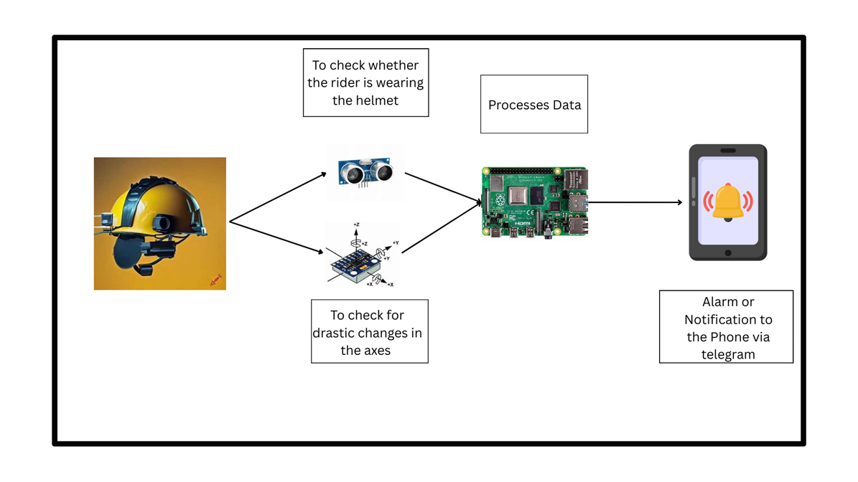
System Architecture
Input Devices:
MPU6050 (detect crash)
Ultrasonic sensor (verify helmet worn)
Processing Unit:
Raspberry Pi 4 (process inputs and detect events)
Communication Layer:
WiFi (connect to internet)
Telegram Bot API (send alerts)
Output:
Sends emergency SOS message with crash details to designated contacts.
Optional: GPS module can be added for real-time location sharing in the future.
(Add a simple block diagram: Sensors → Raspberry Pi → WiFi → Telegram → Emergency Contact)

Slide 10
Future Enhancements
Health Monitoring
AI Crash Detection
Direct Emergency Communication
Broader Adoption
Integration of heart rate sensors to monitor rider’s vital signs during rides for added safety.
Enhancing algorithms with artificial intelligence to improve detection accuracy and reduce false alarms.
Targeting market expansion to include cyclists and other helmet users for widespread safety improvements.
Development of direct communication channels with emergency responders, bypassing phone dependency.

Slide 11
References
WHO Global Status Report on Road Safety 2023 https://www.who.int/publications/i/item/9789240066487
MPU6050 Accelerometer + Gyroscope Sensor Datasheet https://www.invensense.com/products/motion-tracking/6-axis/mpu-6050/
Raspberry Pi 4 Official Documentation https://www.raspberrypi.org/documentation/
Telegram Bot API Developer Guide https://core.telegram.org/bots/api
IEEE Xplore Articles on IoT-based Crash Detection and Emergency Systems https://ieeexplore.ieee.org/Xplore/home.jsp
Research Papers on Helmet Safety and Smart Wearables in Transportation https://scholar.google.com

